Slide 1

Theoretical concepts: Machine Learning and Metaheuristic
Shashank Singh 21mia1110
Dazzle a j 21mia1119

Slide 2
Algorithms used
Random Forest
Support Vector Regressor
Genetic Algorithm
Machine Learning Algorithms
Metaheuristic Algorithms
Ant Colony Optimization

Slide 3
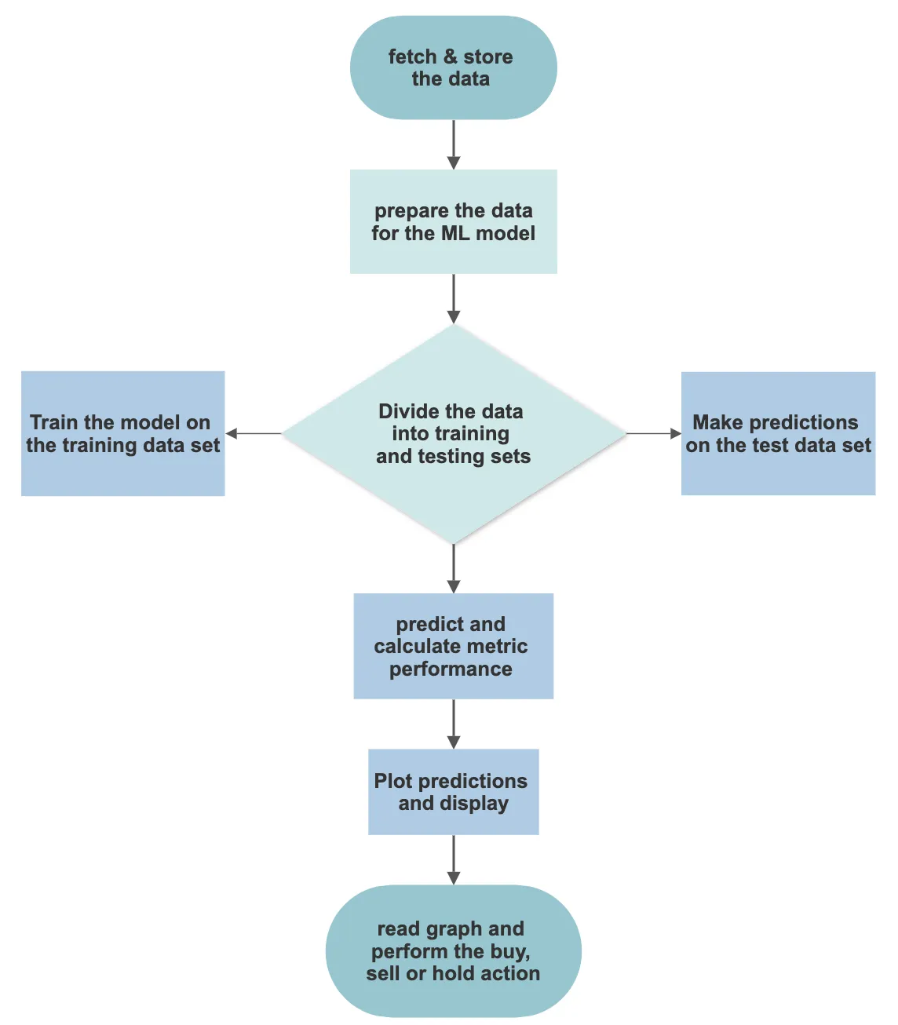
Random Forest
Random Forest is a popular machine learning algorithm that belongs to the supervised learning technique. Here's how Random Forest works:
Data preparation: The first step is to prepare the dataset. This involves cleaning the data, handling missing values, and converting categorical variables into numerical form if necessary.
Bootstrapped sampling: Random Forest uses a technique called bootstrapped sampling or bagging.
Decision tree construction: For each bootstrap sample, a decision tree is constructed. Decision trees are built by recursively splitting the data based on certain features and their values
Random feature selection: At each split in the decision tree, Random Forest considers only a subset of features instead of using all features.
Ensemble prediction: Once all the decision trees are constructed, predictions are made by aggregating the results from each tree.
Out-of-bag evaluation: Random Forest provides a built-in validation mechanism called out-of-bag (OOB) evaluation.
Feature importance: Random Forest can also provide an estimate of the importance of each feature in the prediction.

Slide 4
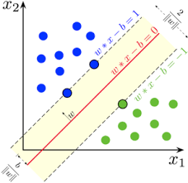
Support Vector Regressor
A Support Vector Regressor (SVR) is a machine learning algorithm that is used for regression tasks. It is an extension of Support Vector Machines (SVMs). Here's how Support Vector Regression works:
Data preparation: As with any regression task, the first step is to prepare the dataset. This involves cleaning the data, handling missing values, and scaling the features if necessary.
Kernel selection: SVR uses a kernel function to transform the data into a higher-dimensional feature space. This allows the algorithm to find nonlinear relationships between the features and the target variable.
Loss function: SVR aims to minimize the error or deviation between the predicted values and the actual values.
Optimization: SVR formulates the regression problem as a convex optimization problem. The objective is to minimize the loss function while satisfying a margin of tolerance.
Margin and hyperplane: SVR aims to find a hyperplane that separates the support vectors in feature space.
Prediction: Once the SVR model is trained, it can be used to make predictions on new, unseen data. The model computes the output based on the learned parameters and the kernel function applied to the input features.

Slide 5
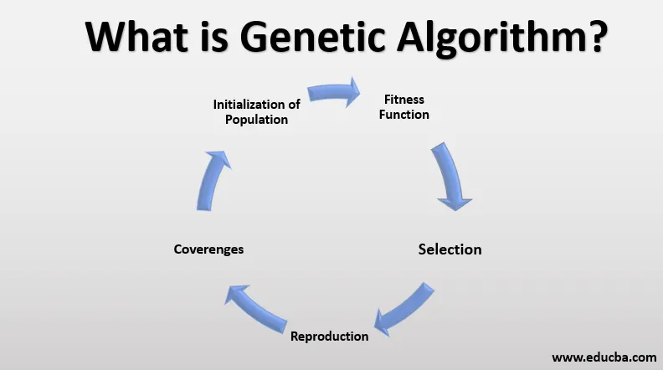
Genetic Algorithm
Genetic Algorithms (GAs) can be applied to prediction tasks as an optimization technique for finding optimal or near-optimal solutions in a search space. GAs are inspired by the process of natural selection and evolution. Here's how you can use a Genetic Algorithm for prediction:
Define the problem: Clearly define the prediction problem you want to solve. Specify the input features, the target variable to predict, and the evaluation metric you want to optimize.
Encoding: Represent each candidate solution (individual) in the population as a chromosome or a string of genes.
Initialization: Generate an initial population of candidate solutions randomly or using some heuristic.
Fitness evaluation: Evaluate the fitness of each individual in the population.
Selection: Select individuals from the population for reproduction based on their fitness scores.
Reproduction: Perform genetic operators, including crossover and mutation, to create new offspring.
Replacement: Replace some individuals in the population with the newly created offspring.
Termination: Determine the termination condition for the algorithm.
Output: Once the algorithm terminates, select the best individual (or multiple individuals) from the final population as the prediction model.

Slide 6
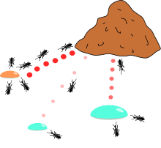
Ant colony Optimization
The Ant Colony Optimization (ACO) algorithm is a metaheuristic inspired by the foraging behavior of ants. Here's an overview of how you can use the Ant Colony Optimization algorithm for prediction:
Define the problem: Clearly define the prediction problem you want to solve.
Encoding: Represent each potential solution as a sequence of decision variables.
Initialize pheromone trails: Assign an initial amount of pheromone to the edges of the problem graph.
Construct solutions: Generate candidate solutions by simulating the behavior of ants.
Local pheromone update: After an ant has made a decision, update the pheromone level on the corresponding edge based on the quality of the decision.
Global pheromone update: Once all ants have constructed their solutions, perform a global pheromone update.
Evaporation: Reduce the pheromone levels on all edges to simulate the evaporation of pheromone over time.
Termination: Determine the termination condition for the algorithm.
Output: Once the algorithm terminates, select the best solution found so far as the prediction model.

Slide 7

Thank You

